Slide 1

Cloud services concepts. Introducing Microsoft 365
Module 1
SoftUni Team
Technical Trainers
Software University
http://softuni.bg

Slide 2
Questions
sli.do # SaaS-Security

Slide 3
Table of Contents
Introduction to Cloud computing
Plan and design your IT infrastructure
Core Microsoft 365 services
Create and setup a new tenant
Demonstration

Slide 4
Introduction to Cloud computing

Slide 5
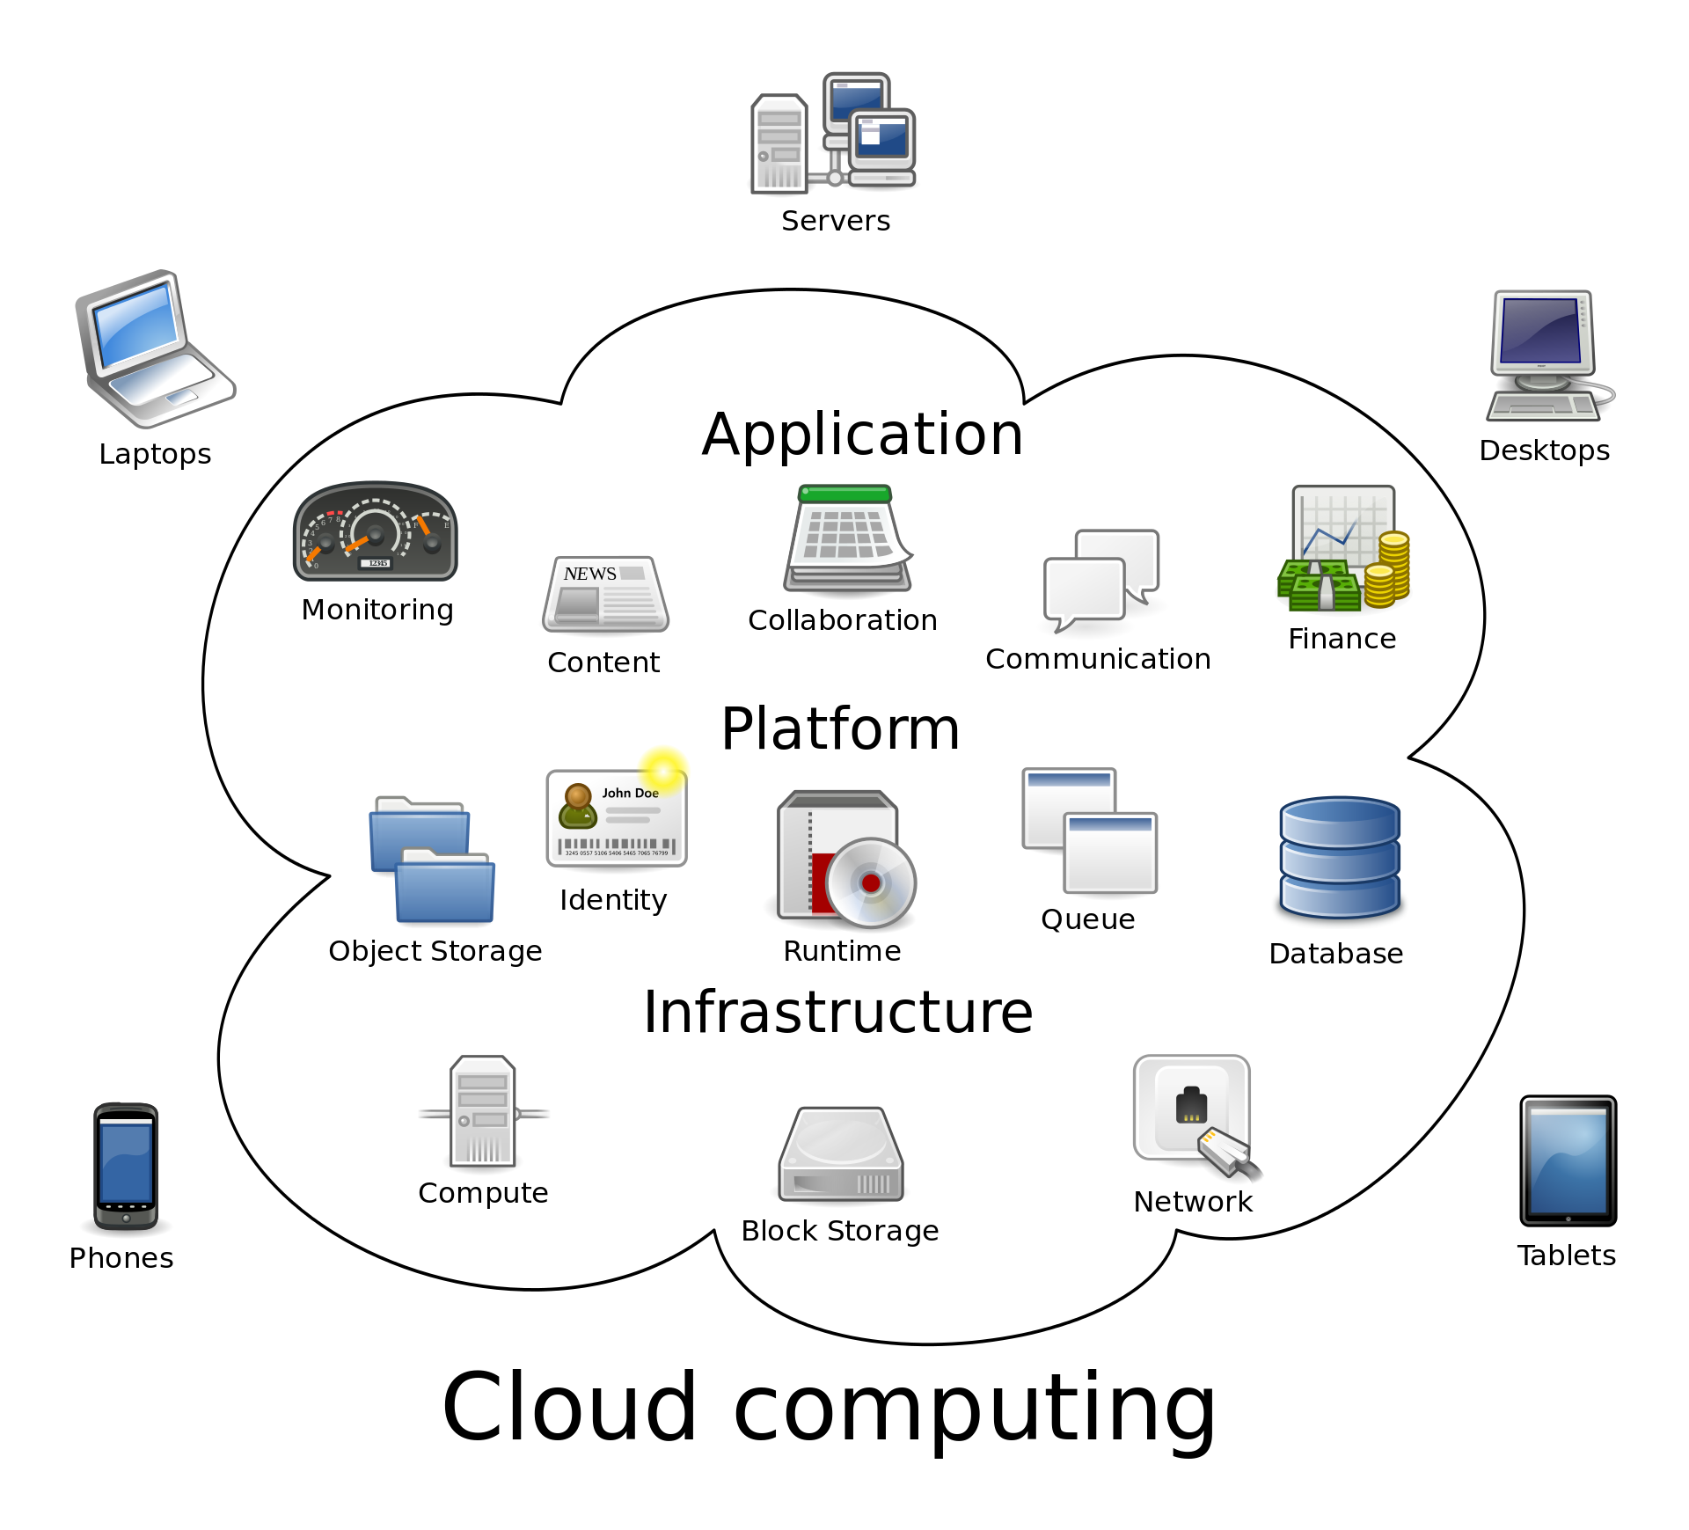
What is Cloud computing?
Computing services are delivered over the Internet, a.k.a “the cloud”
Computing services can be:
Servers
Storage
Networking
Databases
Software

Slide 6


The benefits
Flexible
Fast for deployment
Scalable
Meets new regulations
Secure
Cost-effective
Really?

Slide 7
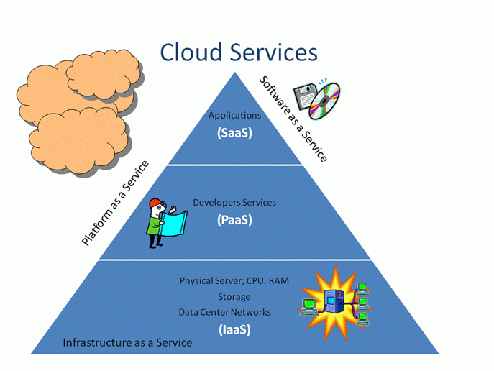
Types of Cloud services

Slide 8
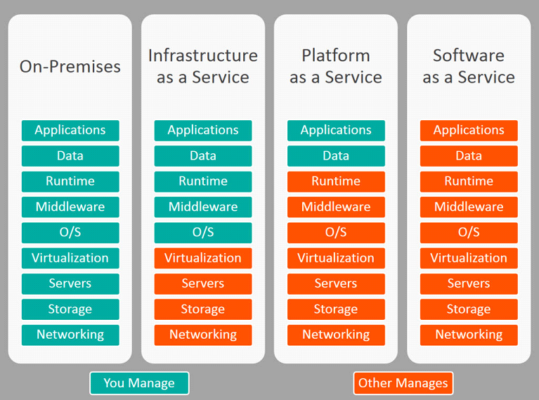
Types of Cloud services (2)

Slide 9



Public vs private vs hybrid cloud
Public cloud:
Operated by third-party cloud service provider
Each customer has its own isolated “tenant”
Security?
Private cloud:
The hardware and the software are dedicated to your organization
Can be hosted locally or at a service provider
More flexible
Hybrid cloud:
The best of both worlds
Data and apps can be moved between public and private clouds for greater flexibility

Slide 10

Challenges
Security
Compliance
Cost
Reliability
Lack of expertise
Vendor lock-in
Notes:
Compliance note: J.P. Morgan created its own private cloud in 2016 and moved some applications into the public cloud in May 2017 - https://blogs.wsj.com/cio/2017/03/30/j-p-morgan-set-to-run-first-apps-in-public-cloud/
Reliability note: For example, less than 99.9% availability of Exchange Online, results in “service credit” of 25%. Less than 99% -> 50% of service credit and less than 95% -> 100% of service credit

Slide 11
Plan and design your IT infrastructure

Slide 12
Why planning your IT is important
As general rule, IT is here to support the Business!
Either starting from scratch or inheriting an existing IT environment, start with some questions:
What does the business need? (and not the technologies)
What are the IT challenges that the IT people are currently facing?
What about the regulations?
What will be the cost to implement and the desired solution?
run

Slide 13

“On-premises” vs “In the cloud”
You receive the service you need (almost) immediately
You can plan your expenses
You rely on the public Internet
More services today are released using the “cloud-first” approach
The only option for companies in the past (if it ain’t broke, don’t fix it)
Better control
More customization options
Reliable and secure

Slide 14

On-premises + Cloud = Hybrid
Often there are existing directory services on-premises
Do I need separate accounts for the on-premises services and for these in the Cloud?
Hybrid identity: the way to use the “same account” on-premises and in the cloud

Slide 15
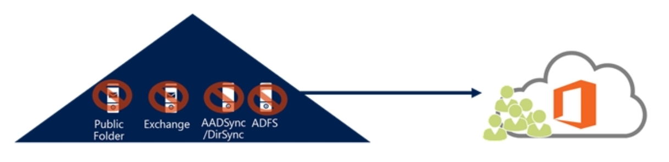
Move totally to the cloud?
Can be done, but usually companies stay hybrid
Pay attention when removing local resources or you can cut yourself from future managing of accounts/mailboxes
Notes:
https://docs.microsoft.com/en-us/exchange/decommission-on-premises-exchange
https://support.microsoft.com/en-us/help/2619062/you-can-t-manage-or-remove-objects-that-were-synchronized-through-the

Slide 16
Core Microsoft 365 services

Slide 17
Microsoft 365 vs Office 365?
Let’s start first with Office 365!
Office 365 is a combination of services, including:
Exchange Online
Planner
Yammer
SharePoint Online
Forms
Kaizala
Microsoft Teams
Delve
Flow
more…
OneDrive for Business
Stream
Power BI
Office 365 ProPlus
Sway
PowerApps

Slide 18

Office 365 metaphor
Outlook, Delve
Excel, Yammer
Stream, Planner
Flow, Teams
Forms, OneNote
PowerPoint, SharePoint
StaffHub, Stream
Sway, OneDrive
Etc…
Office 365

Slide 19












Enterprise Mobility and Security (EMS)
Extend enterprise-grade security to your cloud and SaaS apps
Microsoft Cloud App Security
Microsoft
Intune
Azure Active Directory Premium
Azure Information Protection
Protect your data, everywhere
Protect your users, devices, and apps
Detect threats early with visibility and threat analytics
Microsoft
Advanced Threat Analytics

Slide 20

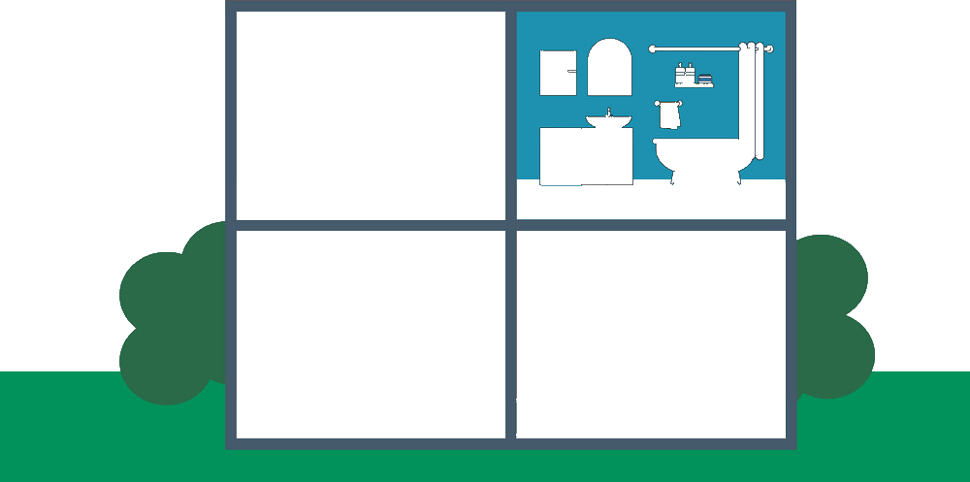
So what is Microsoft 365?
This is Microsoft 365!
EMS – Enterprise Mobility and Security
E
M
S
Outlook, Delve
Excel, Yammer
Stream, Planner
Flow, Teams
Forms, OneNote
PowerPoint, SharePoint
StaffHub, Stream
Sway, OneDrive
Etc…
Office 365
Windows 10

Slide 21
Microsoft 365
Microsoft 365 is a pay-as-you-go SaaS offering that includes Microsoft Office 365, Windows 10, and Microsoft Enterprise Mobility + Security
By combining all these features into a single subscription model, customers can:
Use all the familiar productivity tools available in Office 365
Collaborate using Microsoft Teams, and Skype for Business
Help increase security and compliance
Microsoft 365 addresses the needs of many organizations who want to maximize their adoption of the cloud for productivity, but also for enterprise-grade security and desktop operating system management

Slide 22
Create and setup a new tenant

Slide 23

What is a “tenant”?
Tenant is the company’s space/resources in the cloud.
The tenants are isolated from each-other
Company “C” cloud instance
Company “A” cloud instance
C
A
B
D
Company “B” cloud instance
Company “D” cloud instance

Slide 24
Tenant vs subscription
As discussed, a tenant is the company’s cloud instance
Subscription is agreement (with Microsoft) to use one or more cloud services
Microsoft’s SaaS offerings charge per user, per month
In this course, we will create tenants and will use free/trial subscriptions for them

Slide 25
Office 365 vs Azure
Every Office 365 client is also an Azure client!
Office 365 and Azure services rely on Azure Active Directory (Azure AD) to work with the identities (accounts)
Office/Microsoft 365
Azure
Azure

Slide 26
Prepare for a new tenant creation
There are many things to remember, so organize and prepare to take notes! (OneNote, Google Docs, Notepad, Word, etc.)
Secure and backup your notes
Create an email address to associate your tenant with – can be anything
Be ready to provide your phone number for verification

Slide 27
How to create a new tenant?
Different approaches to create a new tenant by yourself (and not using a Microsoft partner):
Choose a plan and register for a trial subscription (it will also create tenant)
Use a direct link to create a tenant and then associate it with a subscription

Slide 28
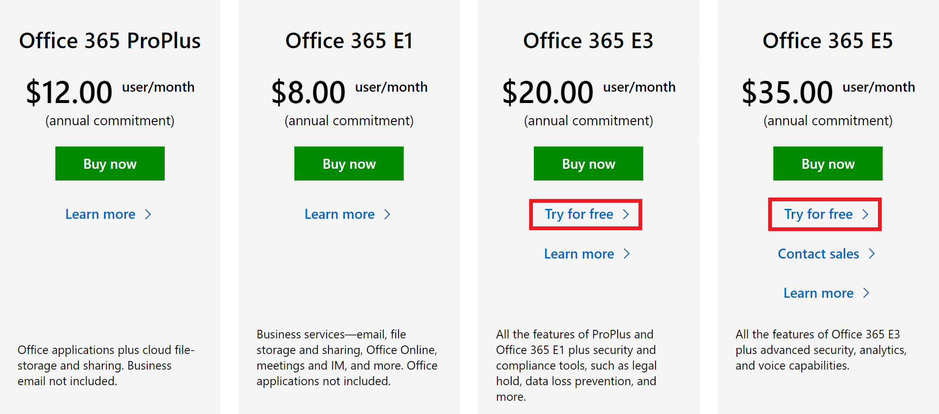
Choose a plan and register for a trial
Different Office/Microsoft 365 plans exist
Good way to start is to go here: https://www.microsoft.com/en-us/microsoft-365/business/compare-more-office-365-for-business-plans and select either Office 365 E3 or Office 365 E5 free trial

Slide 29
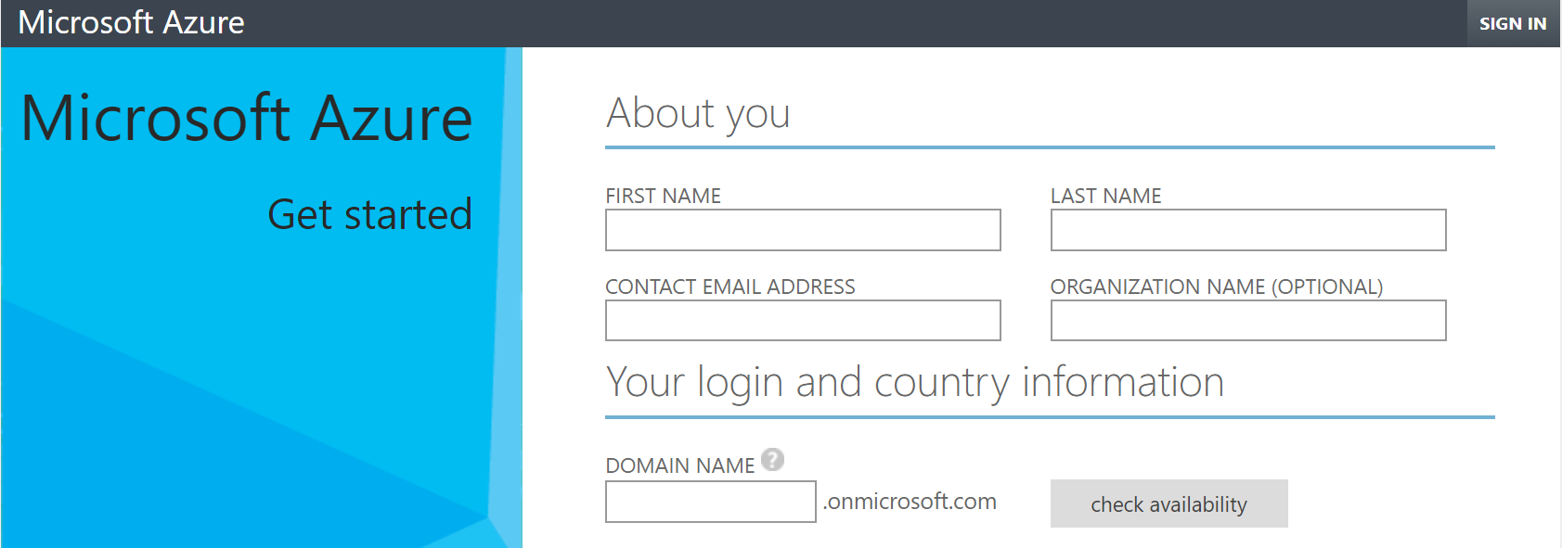
Use a direct link to create a tenant
Create a new tenant using the link below: https://account.azure.com/organization

Slide 30
Demonstration

Slide 31

Summary
Introduction to Cloud computing
Plan and design your IT infrastructure
Core Microsoft 365 services
Create and setup a new tenant
Demonstration
…
…
…

Slide 33



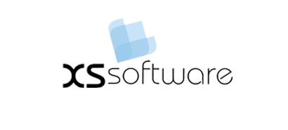


СофтУни диамантени партньори

Slide 34






СофтУни диамантени партньори

Slide 35





Trainings @ Software University (SoftUni)
Software University – High-Quality Education, Profession and Job for Software Developers
softuni.bg
Software University Foundation
http://softuni.foundation/
Software University @ Facebook
facebook.com/SoftwareUniversity
Software University Forums
forum.softuni.bg

